Slide 1
MARKET STUDY OF BEER IN USA
By Kritika Saini (CMSE 201- spring 2020)

Slide 2
Background and Motivation
I am a beer lover so I really wanted to study the market of beer. This topic also intrigued me because my Aunt visited USA long ago and told me beer was very cheap over there. Unfortunately I didn’t agree with this fact when I went to Michigan in the fall of 2019. So I decided to study the rate of change of price of beer over a 16 year period (2000-2016). This project is of my interest and I had a involved and enjoyable time making it

Slide 3
Main Questions (Methodology)
Q1. Have the prices of beer increased over time? How has the average rate of a beer changed with time?
Q2. At what rate has the number of breweries increased in the USA?
Q3. At what rate has the sales of beer increased in the USA?
Q4. Why is the consumption of beer at home more than the consumption of beer commercially(or in restaurants)?

Slide 4
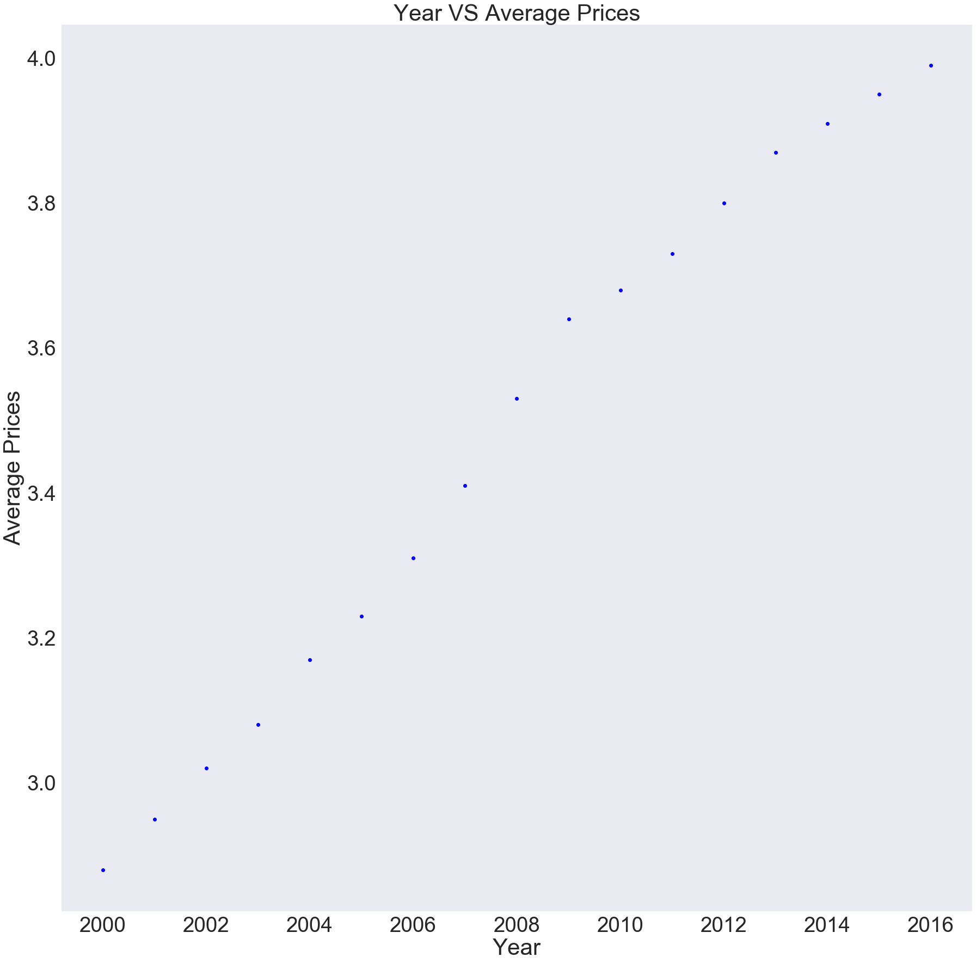
Change in Average price of beer (Q1)

Slide 5
Observation
As we can see in the previous slide, the price of beer has increased over the years. The scatter plot tells us that there has not been a decrease of price of beer between 2000-2016. The rate of change of price is also not a constant, and hence the rate of change of price varies from year to year
When I calculated the rate of change of prices of beer the rate varied from 1.01% to 3.5%, giving a less margin to increase in the price

Slide 6
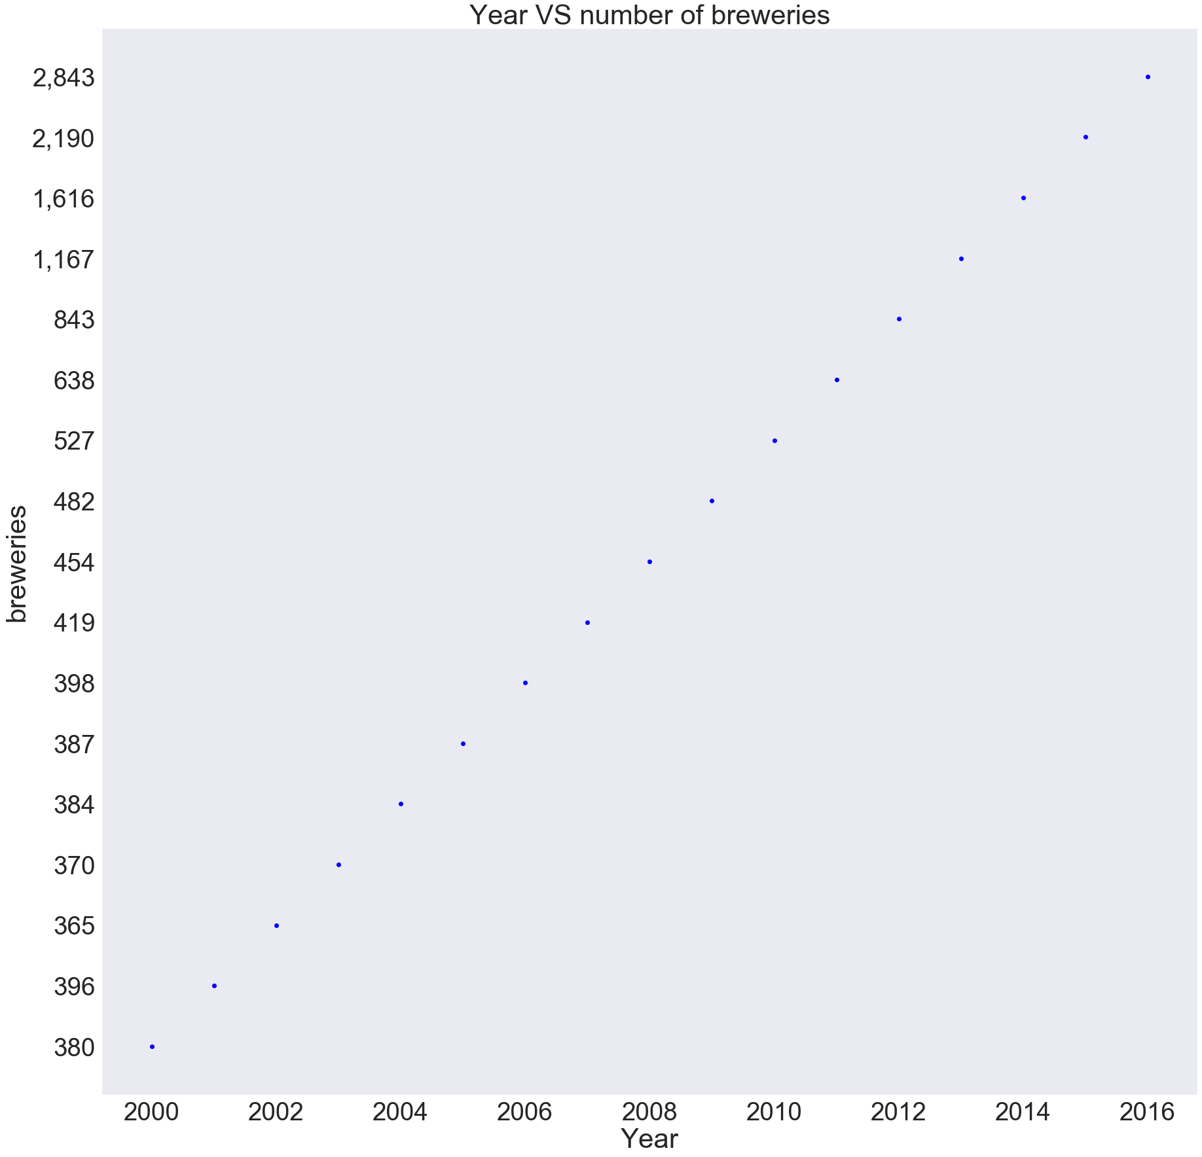
Change in number of Breweries (Q2)

Slide 7
Observation
We can clearly see that the number of breweries have increased over the years
The change varied, from a decreasing rate of 7.82% to the highest increasing rate of 38.47% in the year 2014. This graph shows us linear increase because for y-axis, the code has taken the numbers that are convenient for the respective years, giving us a linear increase, which when seen in a uniform graph, will show us all the intricate increase and decree of numbers

Slide 8
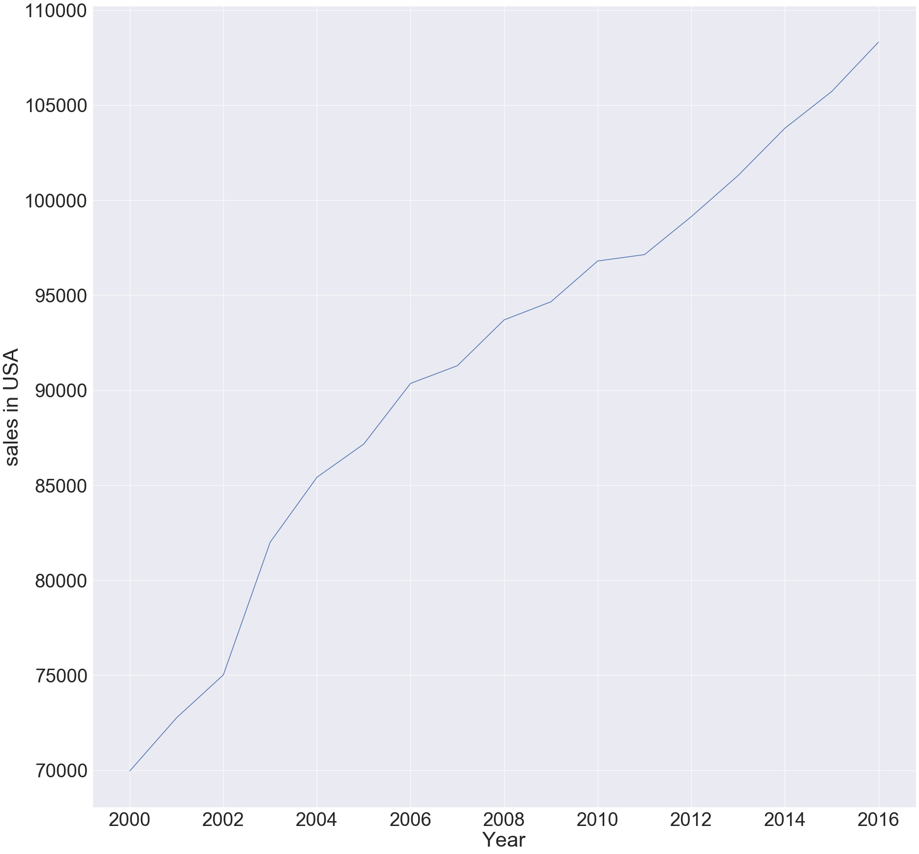
Change in Sales in million $ (Q3)

Slide 9
Observation
As we can clearly see in the graph, the sales of beer has evidently increased. The increase in sales can also be dependent on the increase in number of breweries.
The least percentage change was in the year 2011 at the rate of 0.34%. On the other hand, the highest change in sales was in the year 2003, which was exactly 9.04% more than the least percentage change in sales.

Slide 10
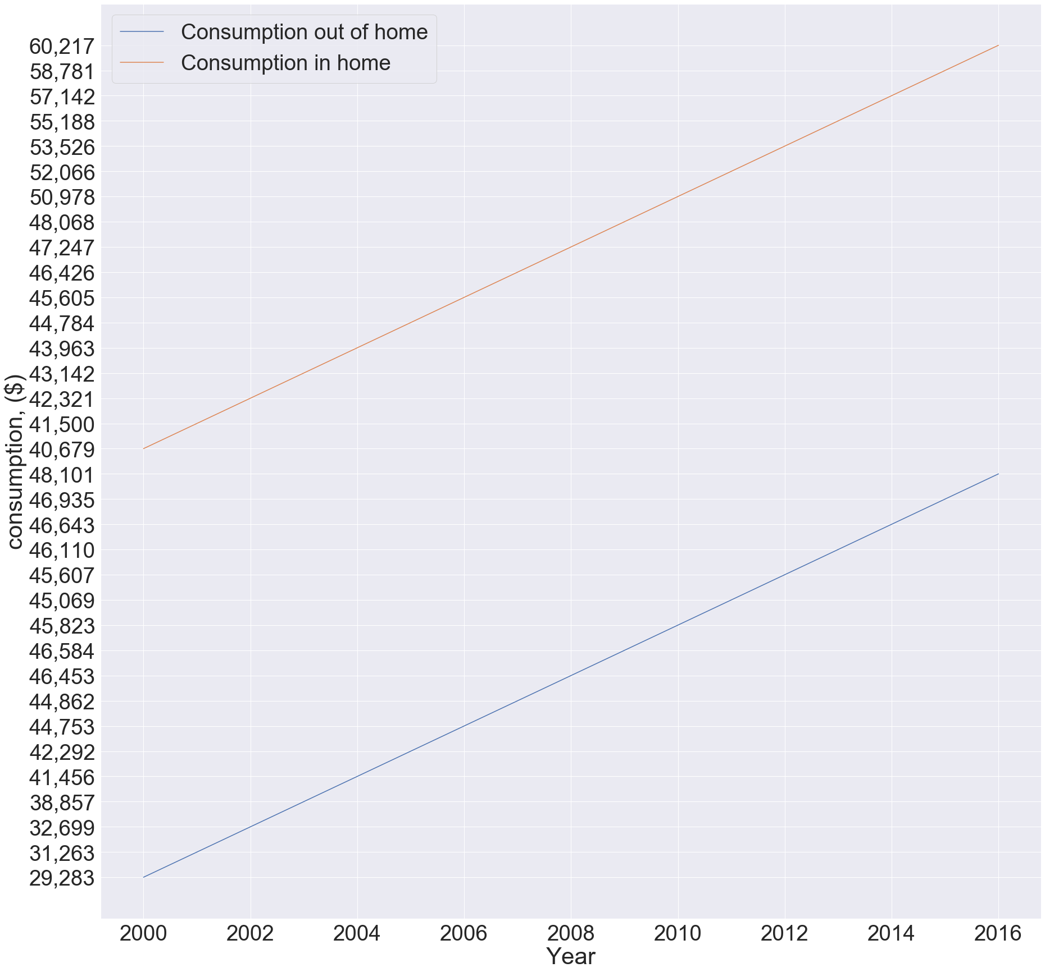
Consumption of beer-in Mln (Q4)

Slide 11
Observation
Observation in this graph is that beer is sold for less money in alcohol or liquor stores and so people tend to buy beer for cheaper amount and consume it at home. Whereas if one goes to a restaurant and buys a beer, one has to pay more for the same brand and same quantity. For this reason beer has always been consumed more in houses rather than in restaurants.
Nonetheless, the consumption of beer in homes and in restaurants has increased in a linear manner, supporting the data from last two topics - increase in number of breweries and increase in the sales.

Slide 12
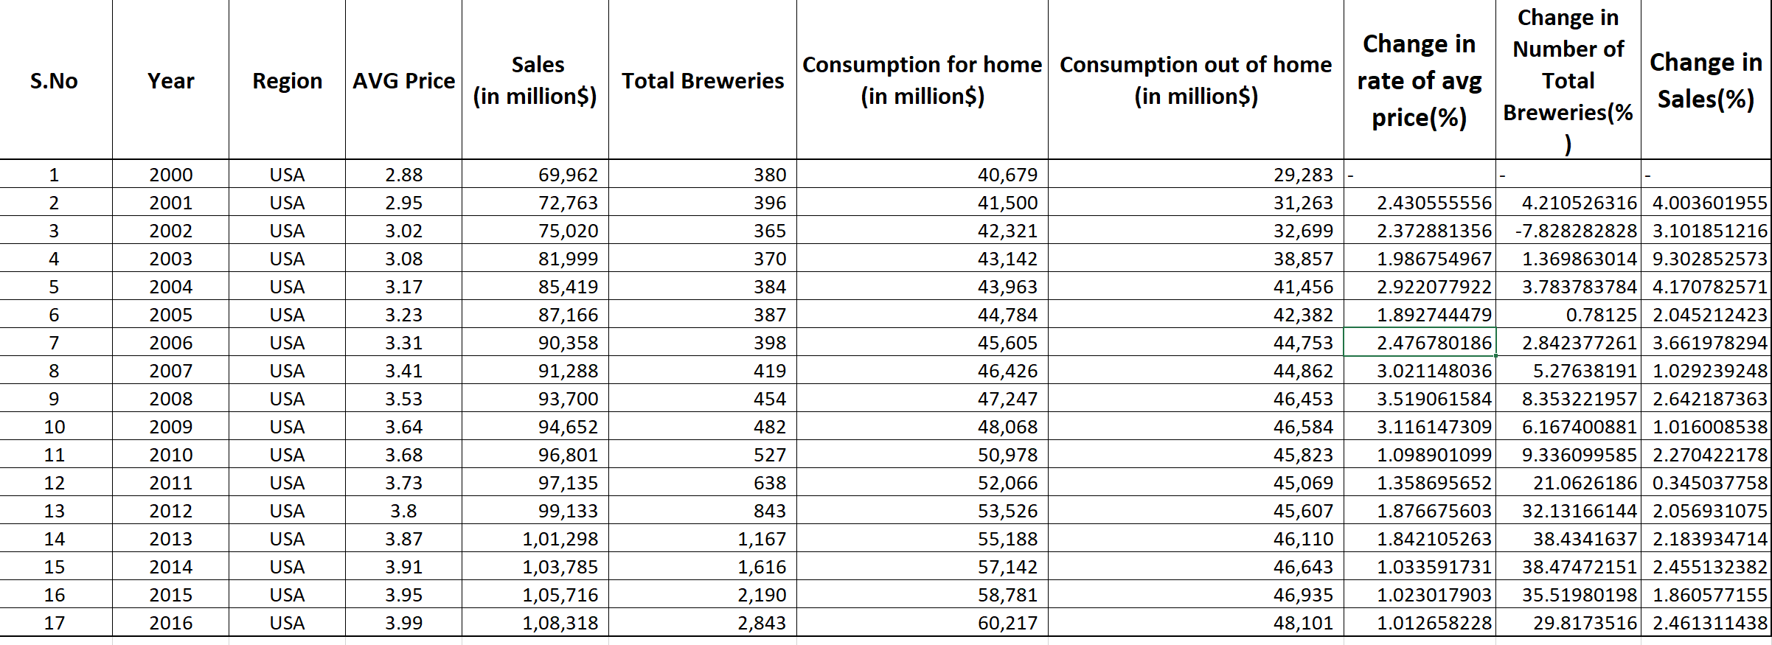
Screenshot of the data used/calculated

Slide 13
Conclusion
After analyzing the whole market share of beer, it can be concluded that over the period of 16 years (2000-2016), the average price has increased by $1.
On the other hand, the beer sales skyrocketed by 55%. Although, according to me the increase in sales percentage does not match the ratio of increase in total number of breweries, as total number of breweries increased 7 times.
Thank you!

